Slide 1

Baselines
Implementations
& Evaluations
Bhaskar Lal Das
bhaskarlda@gmail.com

Slide 2

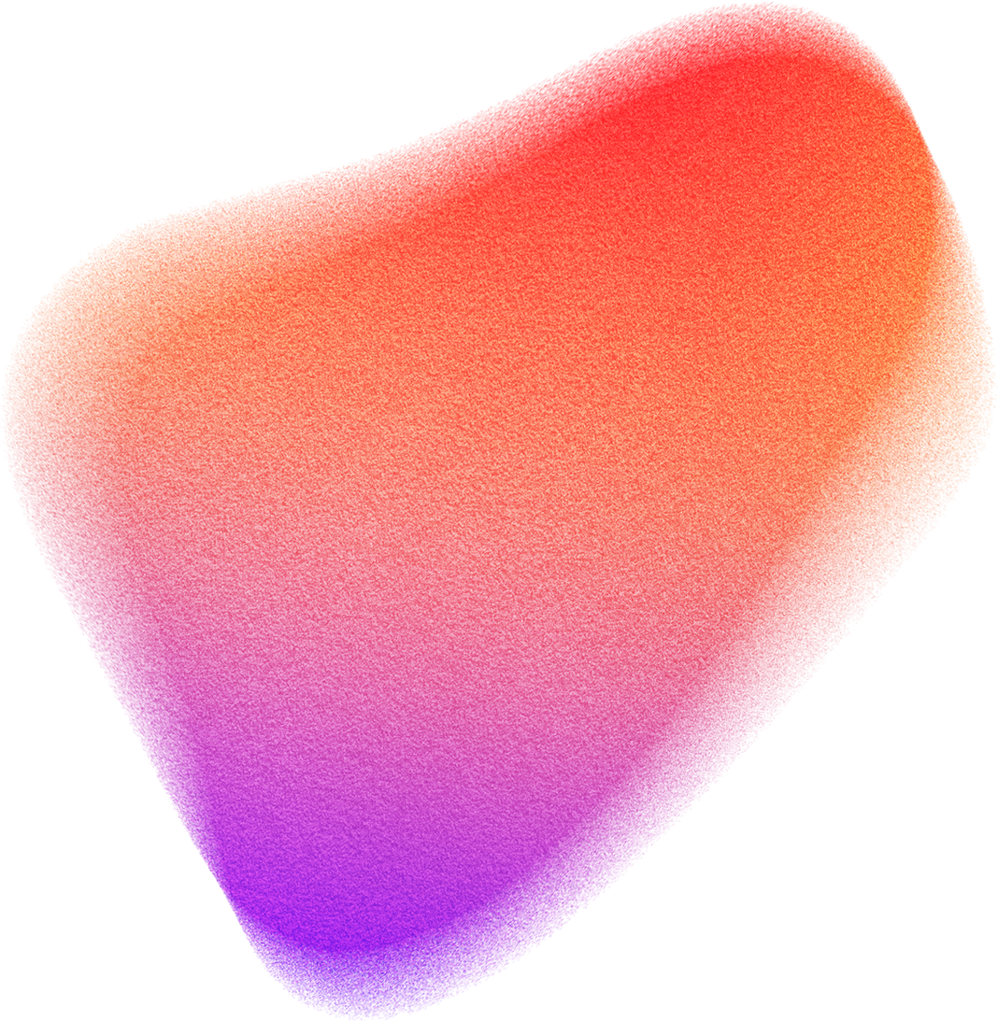
ItemKNN
UserKNN
SVD
SVD++
GridSearch_VAECF
RandomSearch_VAEC
BPR
VBPR
PMF
MCF
LightGCN
NDCF
Random
RECOMMENDATION SYSTEM BASELINES

Slide 3
MAE@k
MSE@k
RMSE@k
R² (R-squared)
NDCG@k
Relative_MRR@k
FCP@k
RECOMMENDATION SYSTEM METRICS

Slide 4
RECOMMENDATION SYSTEM BASELINES
01
02
ItemKNN
UserKNN
Input: User-item interaction matrix: Movie ids, User ids, Ratings
Description:
ItemKNN focuses on item-item similarities based on user interactions predicts ratings based on historical user interactions.
Input: User-item interaction matrix: Movie ids, User ids, Ratings
Description:
UserKNN focuses of user-user similarities based on items they have interacted with and predicts rating based on preferences of similar users.

Slide 5
RECOMMENDATION SYSTEM BASELINES
03
04
SVD (Singular Value Decomposition)
SVD++
Input: User-item interaction matrix: Movie ids, User ids, Ratings
Description:
SVD decomposes the user-item interaction matrix into three lower-dimensional matrices: U, Σ, and V^T and trains for the matrix parameters of latent factors.
Once the matrices U, Σ, and V^T are learned, SVD can make recommendations by reconstructing the user-item interaction matrix using the learned latent factors.
Input: User-item interaction matrix: Movie ids, User ids, Title, Ratings, genre, release_date
Description:
Like SVD, SVD++ decomposes the user-item interaction matrix into lower-dimensional matrices representing users and items.
SVD++ also learns latent factors from the implicit feedback such as the Title, Ratings, genre, release_date.

Slide 6
RECOMMENDATION SYSTEM BASELINES
05
06
GridSearch_VAECF
RandomSearch_VAECF
Input: User-item interaction matrix: Movie ids, User ids, Ratings
Description:
It combines traditional CF with variational autoencoders (VAEs) to learn user and item embeddings.
Grid search is used to search for the optimal combination of hyperparameters by training multiple instance of of the VAECF algorithm.
Input: User-item interaction matrix: Movie ids, User ids, Ratings
Description:
RandomSearch_VAECF combines the functionality of Variational Autoencoder Collaborative Filtering (VAECF) with random search for hyperparameter tuning.

Slide 7
RECOMMENDATION SYSTEM BASELINES
07
08
BPR(Bayesian Personalized Ranking)
VBPR (Visual Bayesian Personalized Ranking)
Input: User-item interaction matrix: Movie ids, User ids, Ratings
Description:
BPR maximize the margin between positive interactions (items that the user has interacted with) and negative interactions (items that the user has not interacted with)
Unlike traditional collaborative filtering methods that aim to predict explicit ratings, BPR focuses on learning a ranking function that can accurately order items based on their relevance to a user.
Input: User-item image matrix: Movie ids, User ids, Ratings, Visual(plots word count matrix)
Description:
The objective is to maximize the likelihood of observing positive user-item interactions and minimize the likelihood of observing negative interactions
VBPR typically consists of three main components: User Embeddings, Item Embeddings, Visual Embeddings

Slide 8
RECOMMENDATION SYSTEM BASELINES
09
10
PMF (Probabilistic Matrix Factorization)
MCF (Matrix Co-Factorization)
Input: User-item interaction matrix: Movie ids, User ids, Ratings
Description:
PMF models each observed interaction as a sample from a Gaussian distribution with mean equal to the inner product of the corresponding user and item latent factor vectors
The objective of PMF is to maximize the likelihood of observing the interactions in the user-item interaction matrix, given the learned user and item latent factor vectors
Input: User-item interaction graph: Movie ids, User ids, Ratings, Plots
Description:
MCF typically consists of two main components User Embeddings, Item Embeddings
The objective of MCF is to minimize the reconstruction error between the observed user-item interactions and the reconstructed interactions predicted by the learned user and item embeddings

Slide 9
RECOMMENDATION SYSTEM BASELINES
11
12
LightGCN (Graph Convolutional Network)
NDCF (Neural Collaborative Filtering)
Input: User-item interaction graph: Movie ids, User ids, Ratings
Description:
LightGCN is designed to learn user and item embeddings by propagating information through the user-item interaction graph using multiple graph convolutional layers
Recommendations are typically generated by computing the similarity between user embeddings and item embeddings using inner product or cosine similarity, and ranking items based on their similarity scores
Input: User-item interaction matrix: Movie ids, User ids, Ratings
Description:
NDCF uses neural networks to capture non-linear relationships and complex patterns in the user-item interactions.
NDCF typically consists of three main components: Embedding Layer, Neural Network Layers, Output Layer
Recommendations are typically generated by predicting the preferences for all items for a given user and ranking the items based on their predicted preferences.

Slide 10
RECOMMENDATION SYSTEM BASELINES
13
Random
Input: User-item interaction matrix: Movie ids, User ids, Ratings
Description:
Random algorithm randomly selects a predefined number of items from the item pool.

Slide 11
01
02
MAE@k (Mean Absolute Error at k)
MSE@k (Mean Squared Error at k)
Average absolute difference between predicted and true ratings or preferences for the top k recommendations
Lower values of MAE@k indicate better accuracy
Average squared difference between predicted and true ratings or preferences for the top k recommendations
Lower values of MSE@k indicate better accuracy
RECOMMENDATION SYSTEM METRICS
03
04
RMSE@k (Root Mean Squared Error at k)
R² (R-squared)
Proportion of the variance in the predicted ratings or preferences that is explained by the model
Higher values of R^2 indicate better predictive performance
Square root of the MSE@k and provides a measure of the average magnitude of the errors
Lower values of RMSE@k indicate better accuracy

Slide 12
05
06
NDCG@k (Normalized Discounted Cumulative Gain at k)
Relative_MRR@k (Relative Mean Reciprocal Rank at k)
It compares the reciprocal rank of the first relevant item in the recommendation list with the reciprocal rank of the first relevant item in a randomly generated list
Between 0 to 1 (ideal)
It considers both the relevance and the ranking position of recommended items
Between 0 to 1 (ideal)
RECOMMENDATION SYSTEM METRICS
07
FCP@k (Fraction of Concordant Pairs at k)
Pairwise ranking metric that measures the fraction of concordant pairs in the top k recommendations
Between 0 to 1 (ideal)

Slide 13
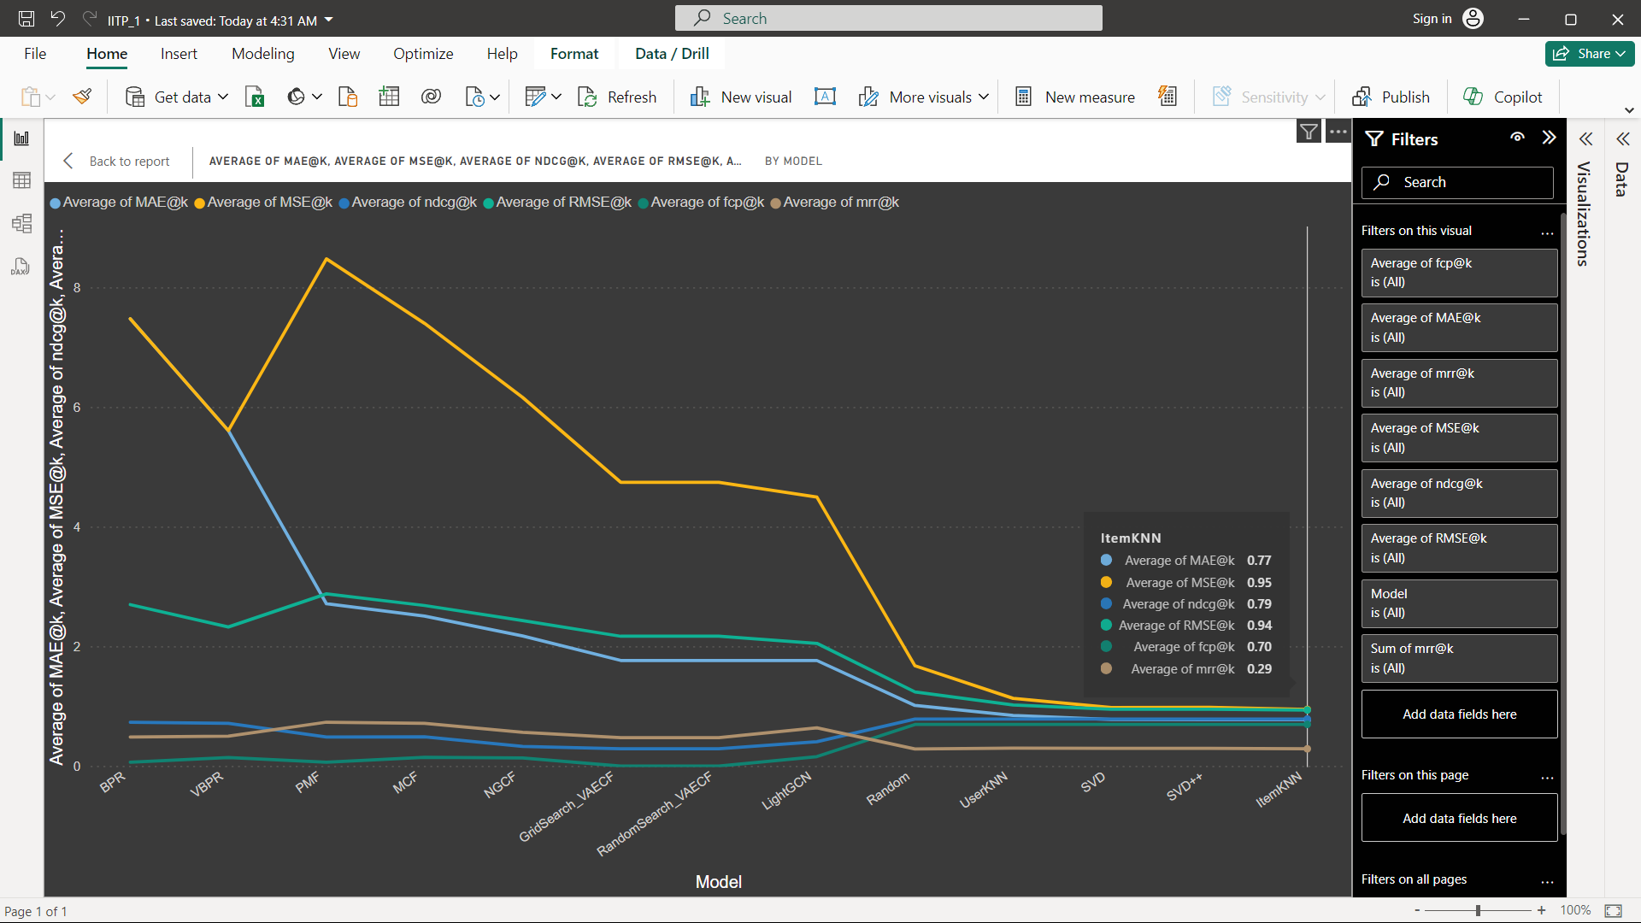
EVALUATION RESULTS

Slide 14

Thank You
Thank you for your attention and time.

